Slide 1

Proposal for Modification of current seat belt mechanism
ADRISH RAY – 108118006
AKSHAT KHANDELWAL - 108118010

Slide 2

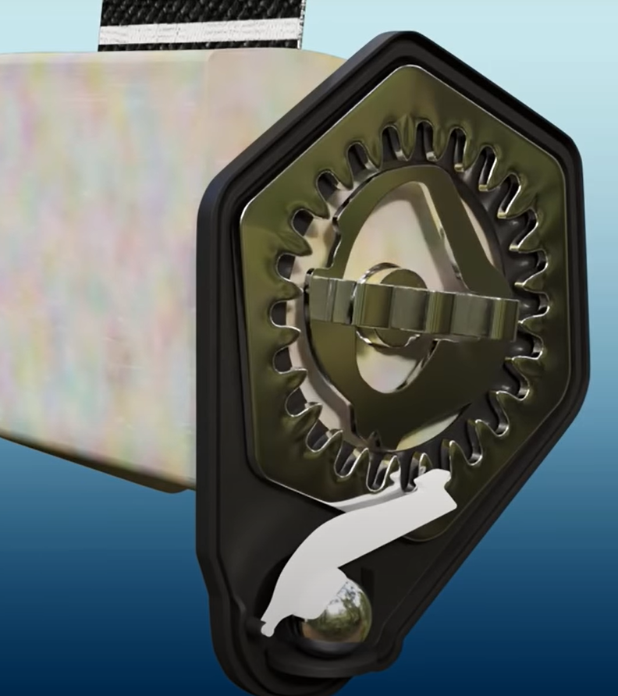
What is being done right now?
Spiral spring is used
3-point design
Steel ball hinge can be used(makes noise when activated)
Mechanism for reducing sudden webbing action
Torsion bars are used to reduce sudden jerks in case of accident(basically releases some belt so that passenger can land on seatbelt comfortably)
Pre tensioners are used to reduce impact of accident

Slide 3
Pros and cons of current approach?
Lots of noise due to steel ball
Electric cars are noiseless and hence more noticeable noise
Electronic feedbacking can work more accurately
Smart decisions cannot be made as its just mechanical thingy, in electronic based system ML models can be collaborated to make it more effective and efficient.
Easier to implement
Cost effective

Slide 4
What are we up to
During accidents we are planning to allow enough moment of the belt so that internal injuries can be minimized and helps to land on airbag safely
According to passenger size enough webbing will be released reducing passenger discomfort during motion while normal movement of the car(in case of accident we are planning to lock the movement passenger)(using data of sudden deacceleration which can be acquired by Acclerometer)(in traditional seatbelts ball mechanism is used)
Can have constrains according to webbing speed so that belt locks if passenger moves forward fast
Basically, we are tying to reduce internal injuries chances by smartly controlling the webbing (torsion bar mechanism)
Pre tensioner mechanism using data from break paddle(detects fast movement of break paddle)(same piston mechanism can be used)

Slide 5
First Solution
Clutch Plate(smaller version of it)

Slide 6

Clutch approach
Basic idea to redesign clutch for use in seatbelt so that we can control the webbing of belt
Spiral spring is still in use, we are just replacing current mechanism with a clutch sort of thingy
Actuation of clutch can be controlled using some sort of linear actuator
Linear actuator is controlled by some microcontroller which can be programmed as per out convivence
E.g., If sudden deacceleration is detected linear actuator releases the clutch and hence stop the webbing(this can be controlled as well using half clutch concept(riding clutch concept)

Slide 7
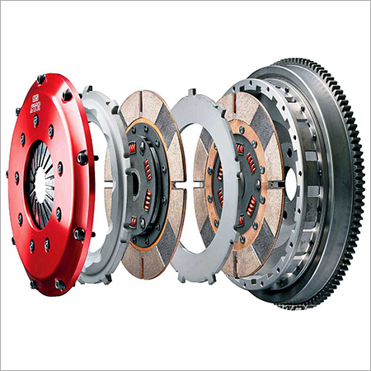
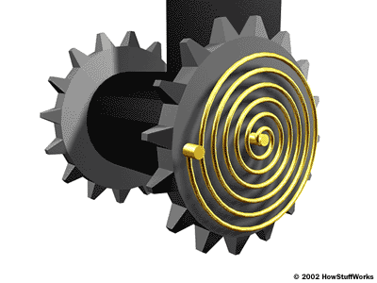
Traditional Cultch
Seat belt

Slide 8
Problems With Proposed Solutions
Clutch plate approach
Heat can be a problem
Will have to design properly according to our use(small)
Linear actuation of the clutch is to be figured out

Slide 9
Second Approach
Locking with levers actuated by microcontrollers.

Slide 10
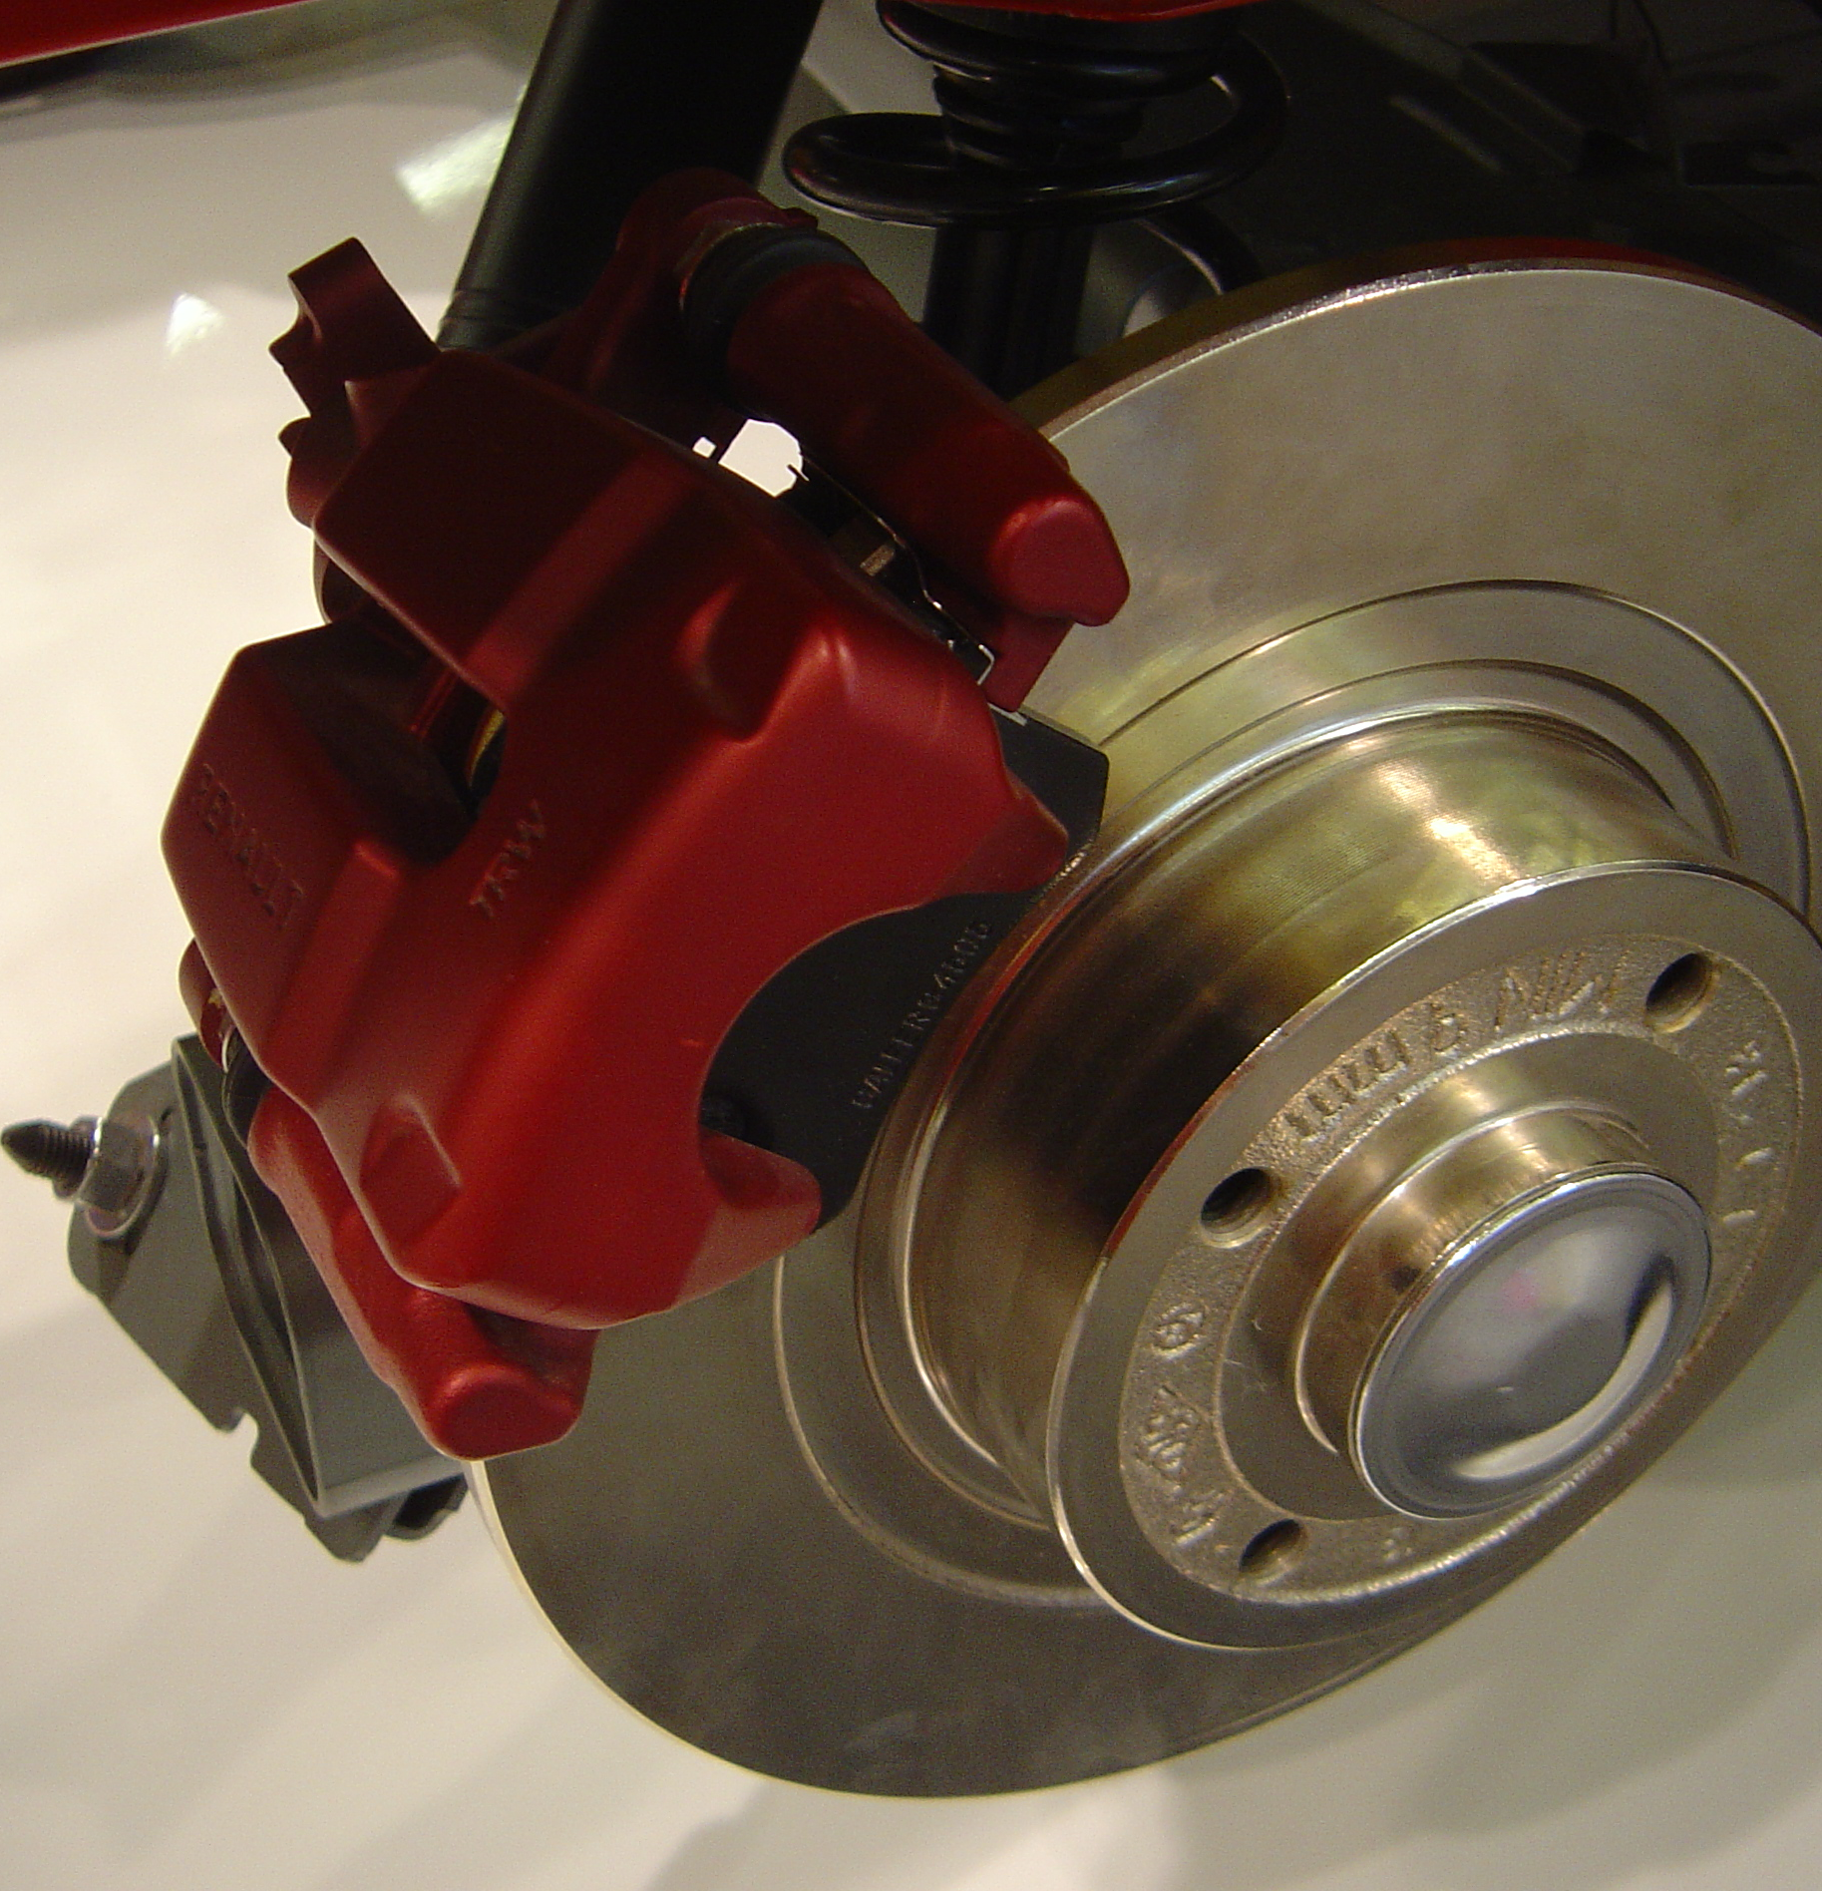
Disc Brake Mechanism
90 mm disc brakes can be used, some mechanism through which breaks can be applied can be figured out.
having smartly controlled electronic controlled brakes system with a MCU unit programmed accordingly

Slide 11
Third Approach
Locking with levers actuated by microcontrollers.

Slide 12
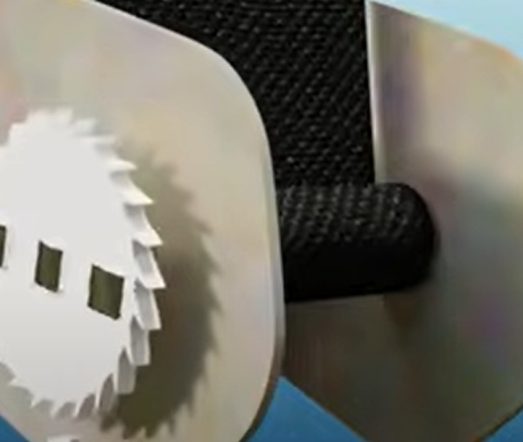
The Approach
The seat Belt setup on the right shows a white gear that is attached to the spool around which the webbing is wound.
The Idea is to stop the rotation of the gear using levers that get locked with the gear.
The Levers in normal conditions will be held just over the gear. During emergency situation the levers will lock into the gear. Thus, the gear will stop rotating. The levers are actuated using servo mechanism through a pre-programmed microcontroller.
This way the webbing can be instantly stopped from further extension during an emergency situation.

Slide 13
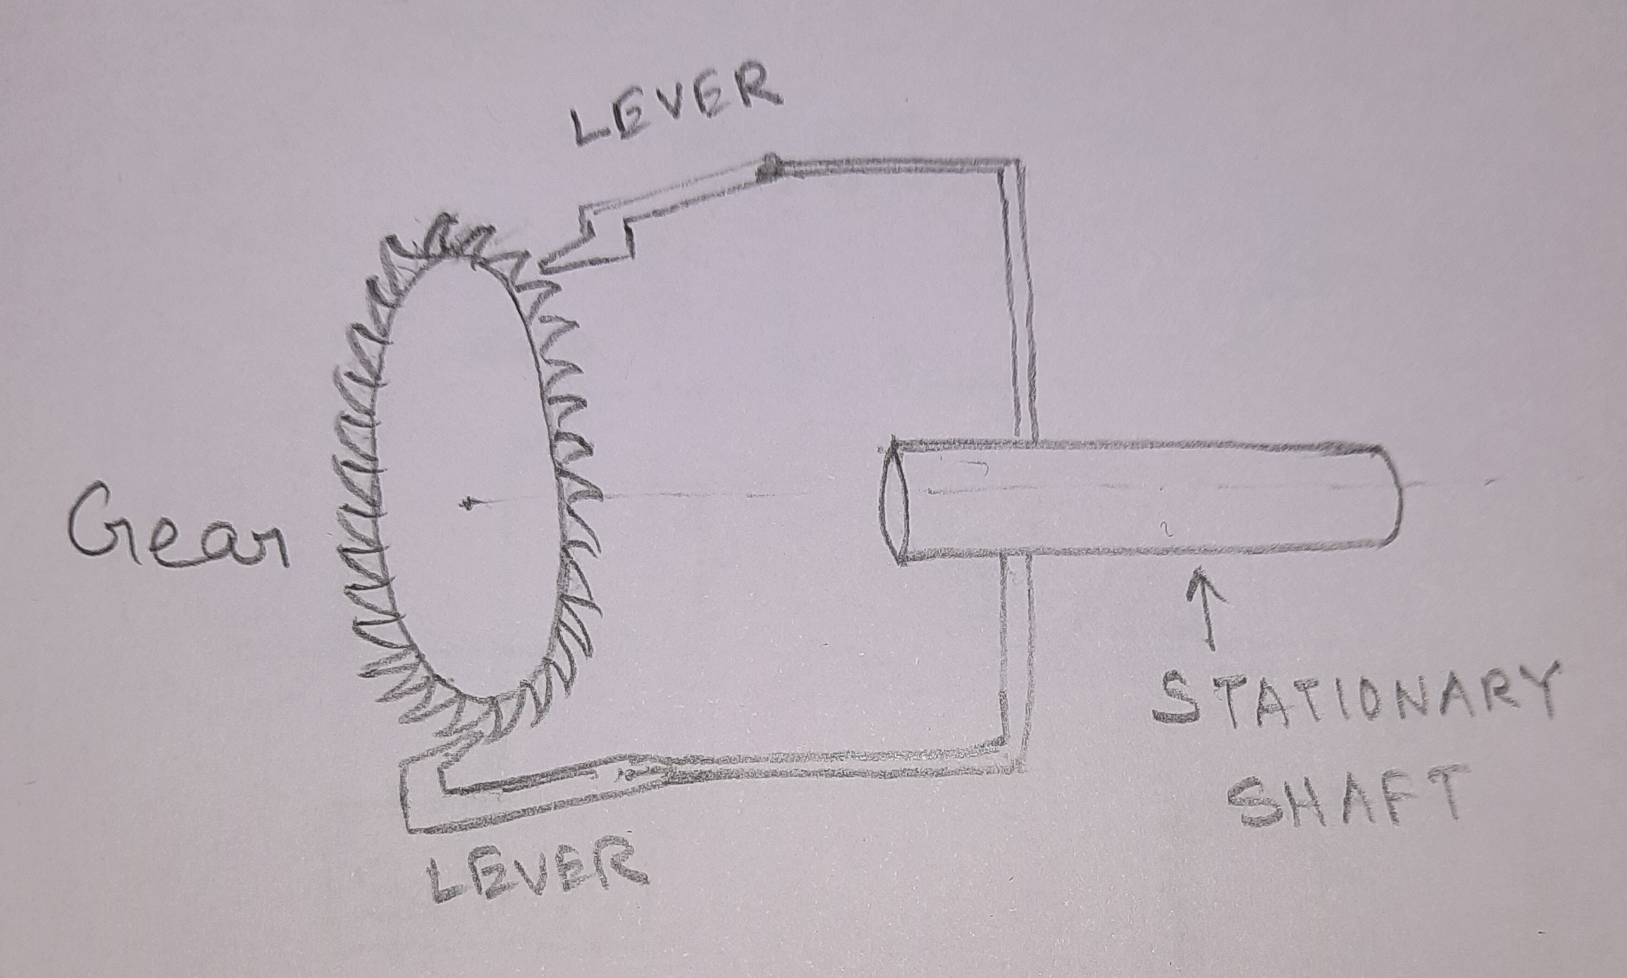
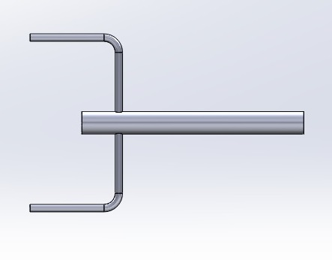
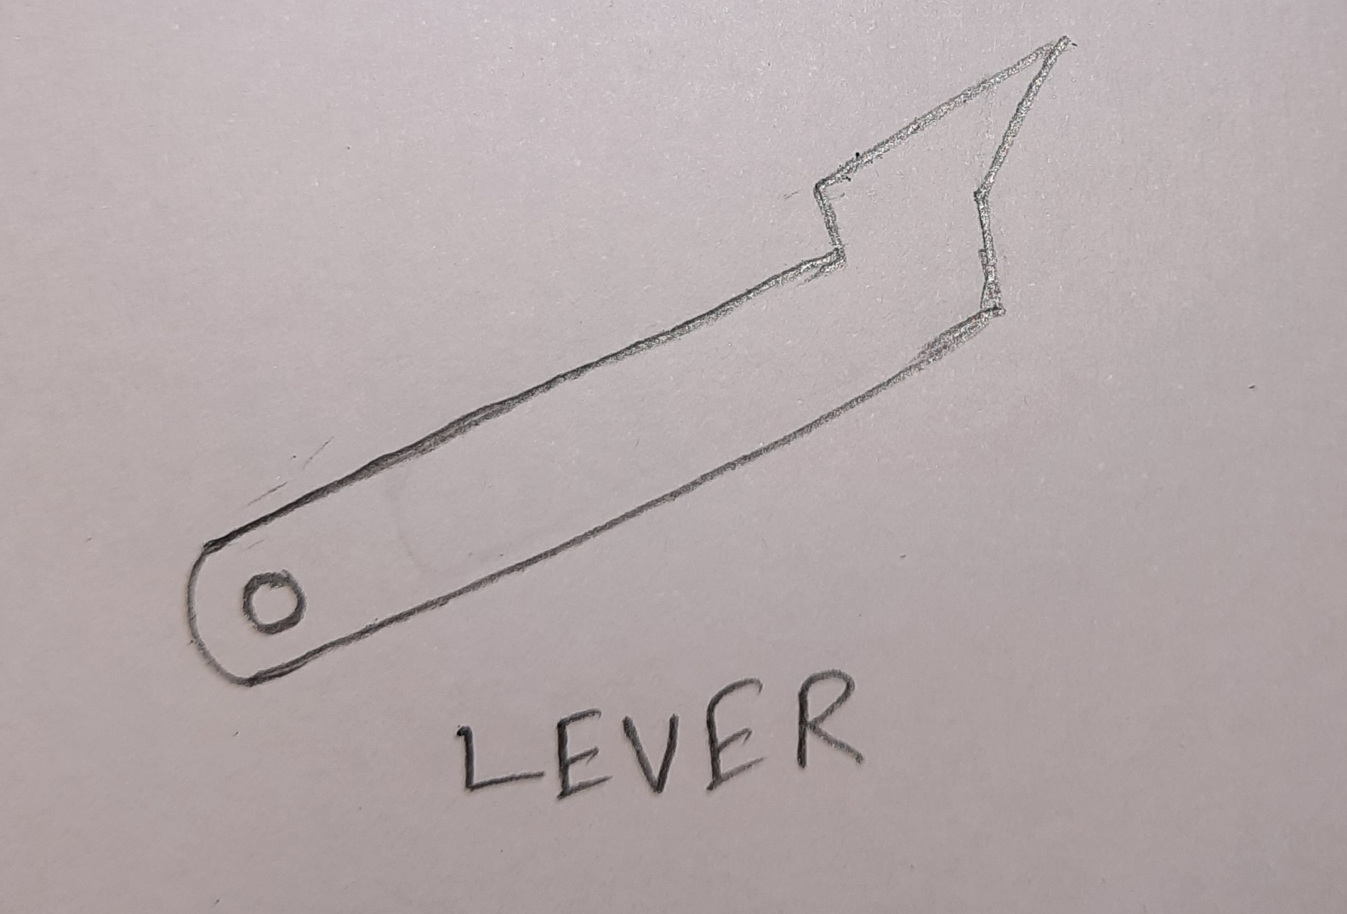
CAD model of the shaft
A rough sketch of the basic working of the mechanism
Levers that will be attached to the shaft

Slide 14

One problem with the instant locking
The instant locking will generate huge amount of impulsive force on the person wearing the seatbelt.
So we decided to have some mechanism that can allow some extension of the webbing so that it does not put very high force on the body.

Slide 15
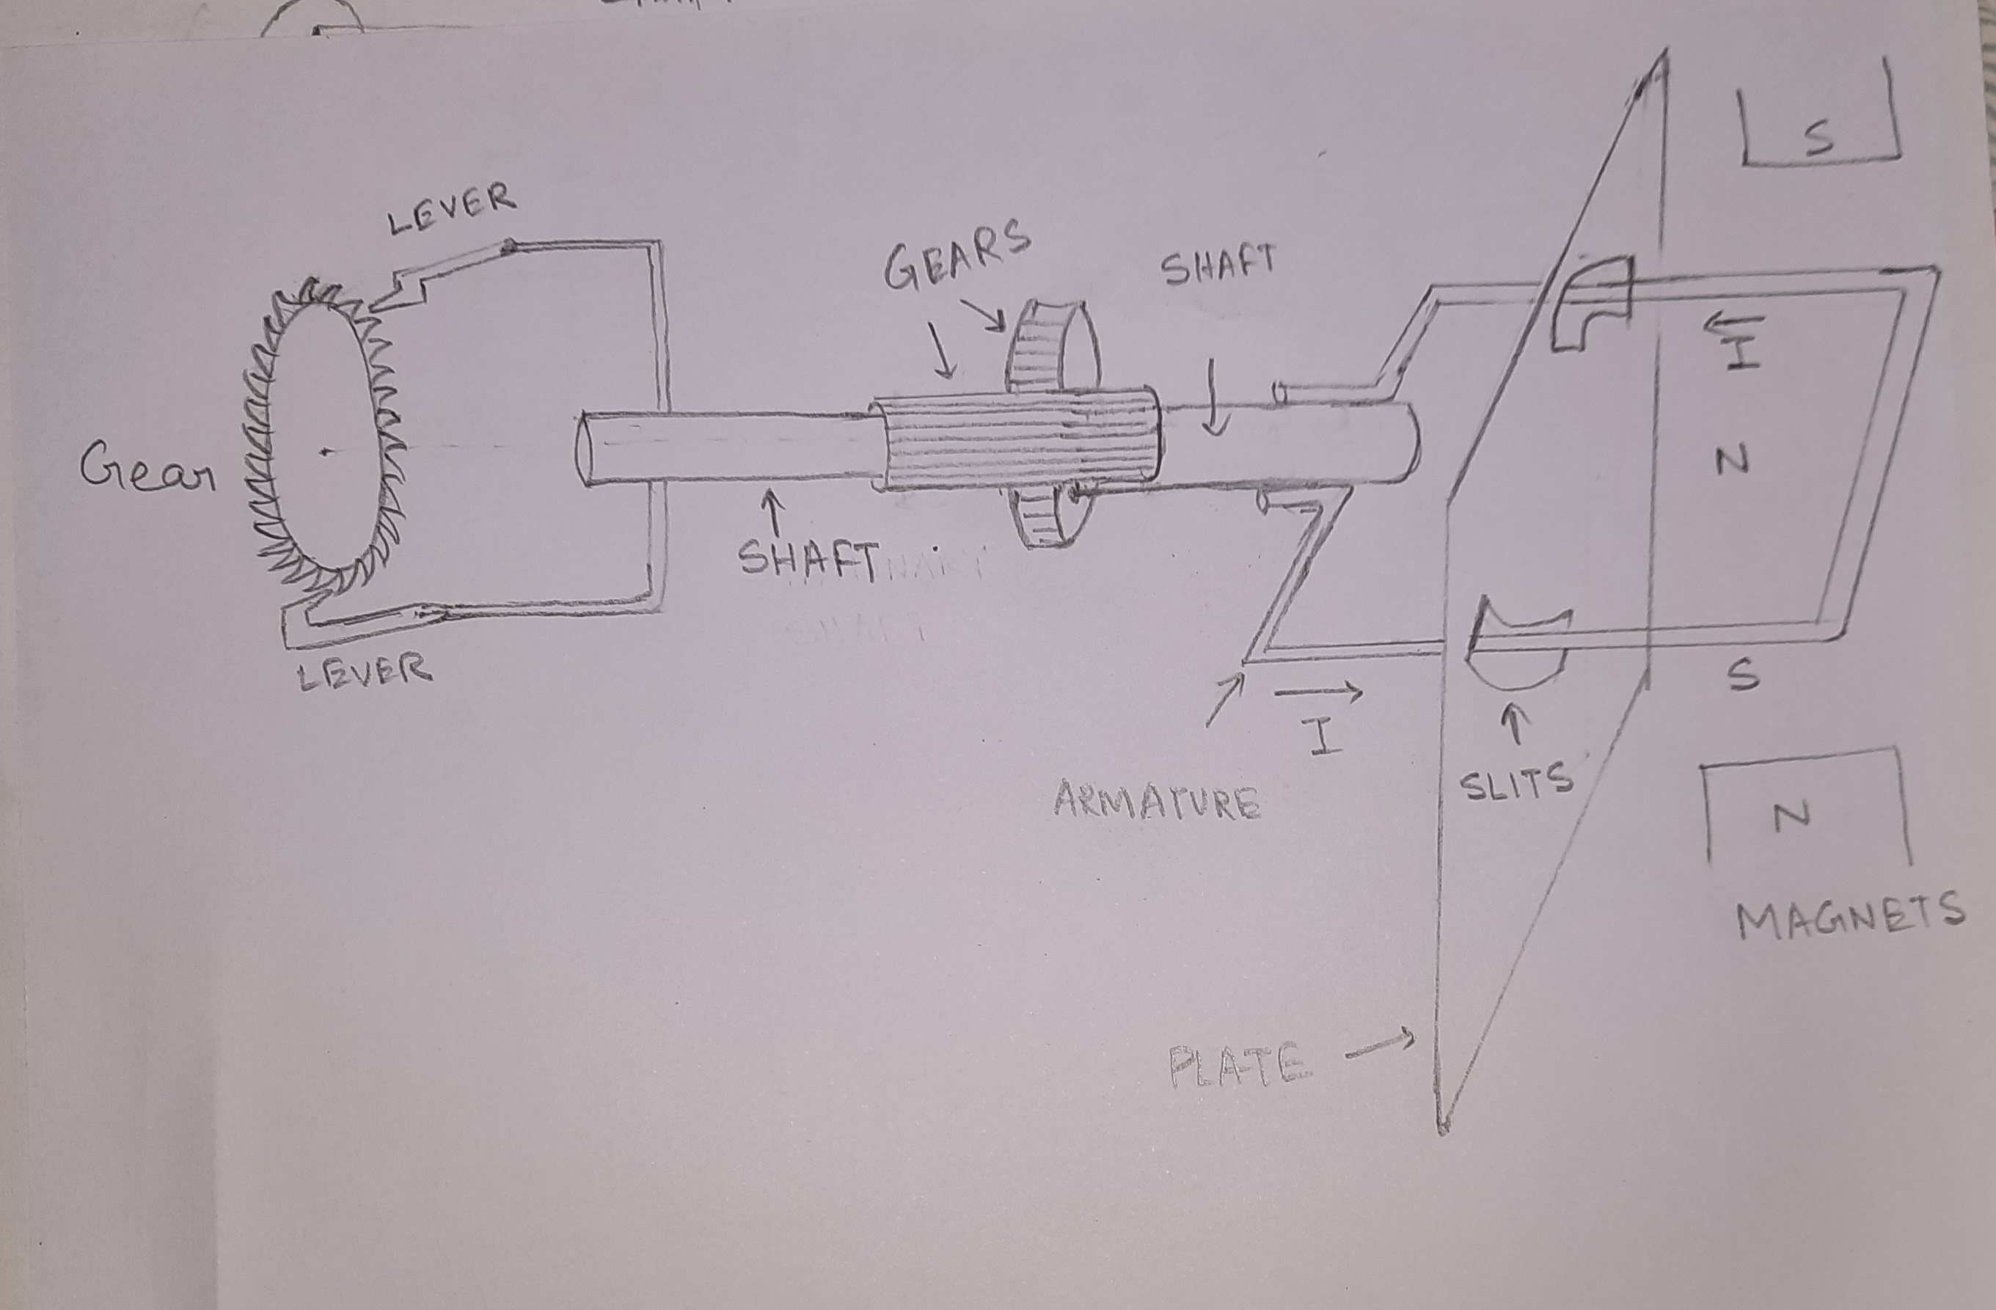
The mechanism which allows some extension of webbing

Slide 16
Why the set-up with armature and magnets.
As soon as the lever gets locked, it tends to rotate the shaft. Due to those gear the armature also starts rotating.
Now as current is flowing through the coil(armature), it behaves as a magnet in equilibrium with the magnets.
As the armature rotates, a counter-torque is generated due to the magnetic field present.
The counter torque due to the magnetic field on the coil will try to stop the rotation of the armature, this in turn stops further rotation of the shaft with levers.
The counter torque produced is given as:
τ=NIABsinθ
The angle theta depends on how much the shaft rotates after the lever getting engaged, before the counter-torque produced by the magnetic field stops the armature.
By controlling the current and the magnetic field of the magnets, enough counter torque can be generated so that the armature stops rotating by the time it rotates by about 90 degrees.
Why the plate with slits:
The plate with slits will also stop the rotation of the of the armature.
The slits will have springs attached to the armature through non-conductive grooves. These springs stretch as the armature rotates, hence offers huge amount of resistance to the circular motion of the armature, thus eventually stopping the shaft with the levers.

Slide 17
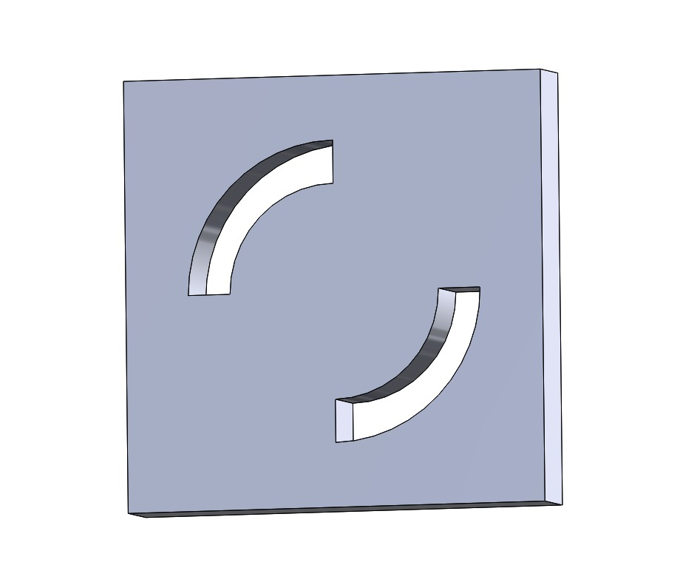
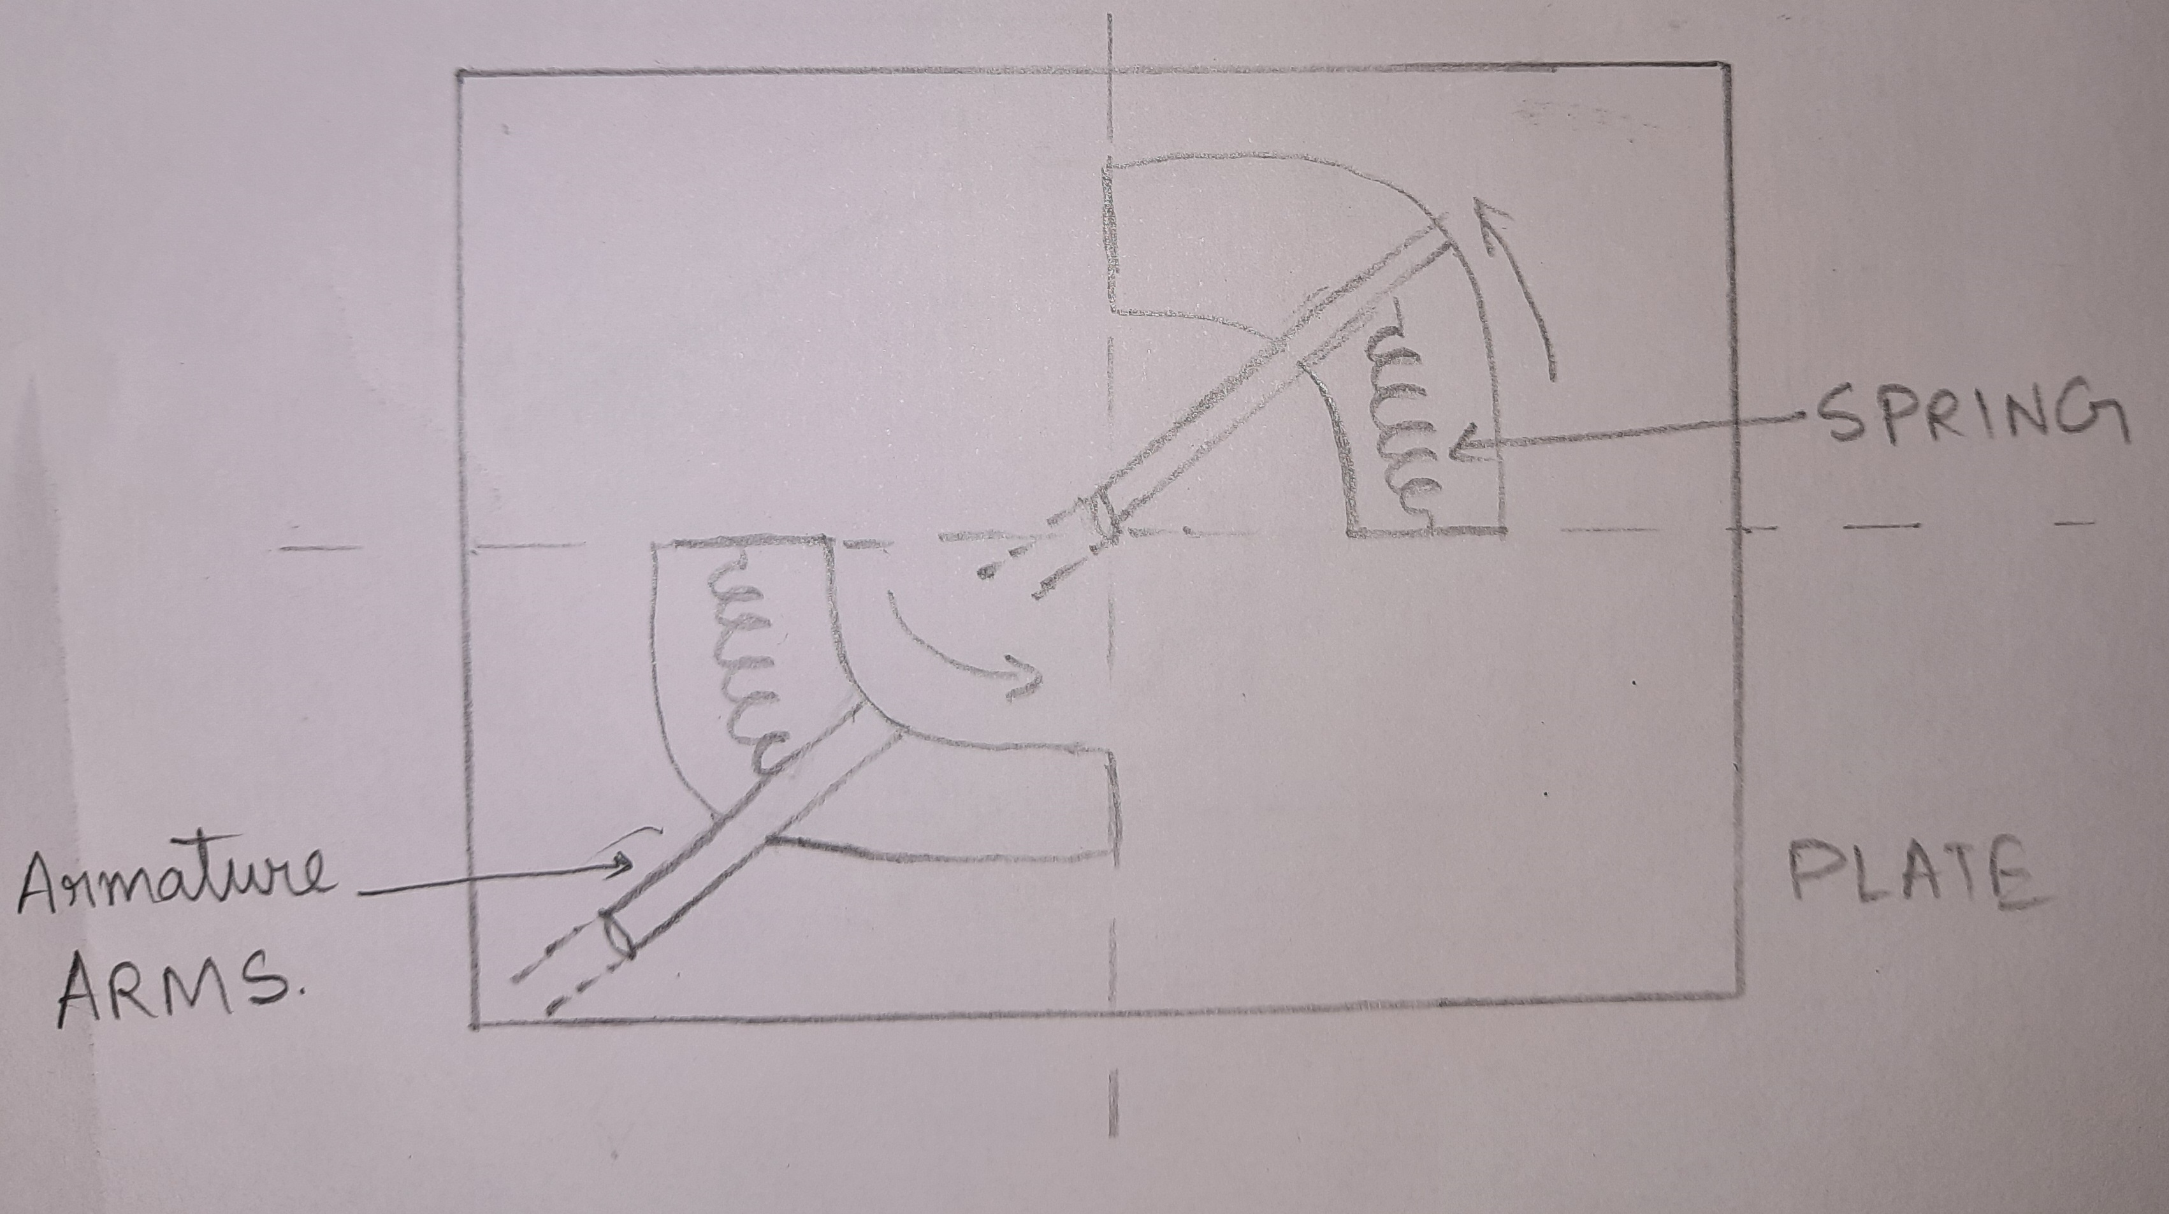
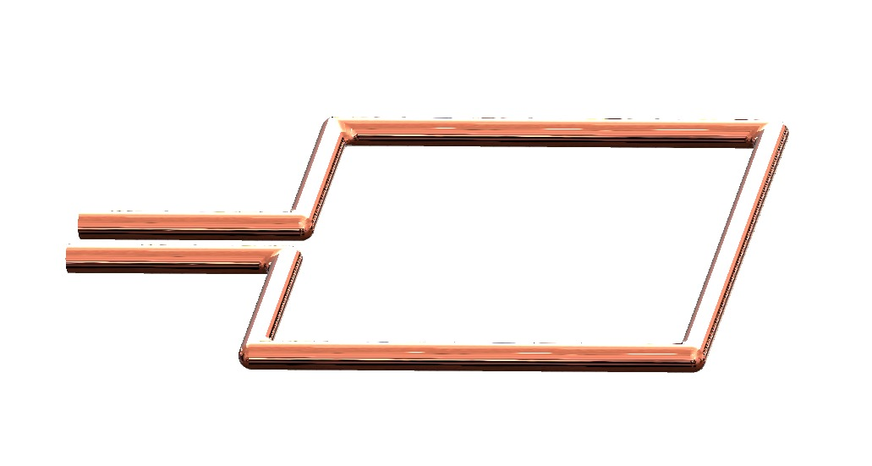
The diagram shows how the springs in the slits stops the armature.
The plate with slits (CAD model)
CAD model of Armature

Slide 18
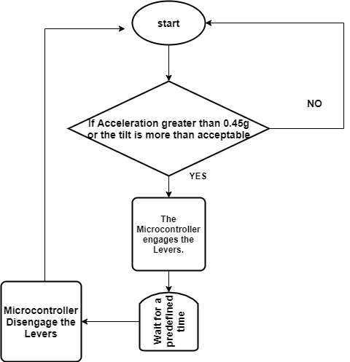
Control of the Levers
The engaging and disengaging of the levers will be controlled by a servo mechanism.
The servo will be actuated by the Microcontroller.
The Micro-controller will take input from Accelerometer and Tilt sensors.
The programming will be done such that whenever an emergency situation is sensed by the sensors, the controller will actuate the servos such that the lever gets locked into the gear.
The electronics components needed:
A microcontroller
Servo motors
Accelerometer
Tilt sensors

Slide 19
Challenges with the proposed solution
Miniaturizing the whole thing can be challenging.
As its based on electric components, loose connections may occur which can affect the operation of the system.
The design of the levers such that they smoothly lock into the geared disk may be challenging.

Slide 20
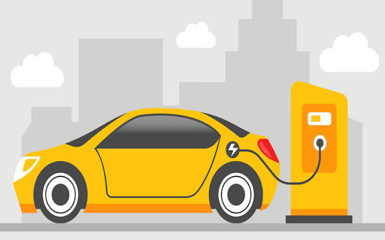
The Market
Whole car industry
Electric vehicle industry

Slide 21
What we need
Someone to design CAD design/ Simulation would be helpful
Someone with expertise in ros to make real time / real world simulations.

Slide 22
Further Modifications:
Intelligent Ignition System : A magnetic encoder is added to the existing ‘Seat Belt Retracting System’, along with a tiny magnet. The encoder records the rotation of the retracting gear and calculates the stretch (the length if belt that has been pulled out) of the seat belt. This way, it can be detected whether the seat belts are applied and hence control the ignition process.
Attention Retention System (ARS): A small camera module is mounted in-front of the driver and is coupled with a processing board (e.g. Raspberry Pi). The camera continuously takes footage. Using suitable image processing algorithms, the processing boards detects the time duration (t) for which the eyes are closed during a blink.

Slide 23

Time-Line
We plan to complete the project in next 2 months
First 3 weeks for simulation
Next 2 - 3 weeks to program microcontrollers and collecting data
Next 2 – 3 for product design(final)

Slide 24
Cost Estimation
Clutch approach:
Around 4-5k per belt.
Disc-Brake approach:
Around 5k per belt.
Locking with levers actuated by microcontrollers
Around 3k per seat belt.

Slide 25
Thank You

